Slide 1


硬岩深部开采矿柱岩爆的分类与机理
Mechanism of Pillar Rockbursts in Underground Hard Rock Mining
Jian Deng
Prof., Ph.D., P. Eng.
E-mail: jian.deng@lakeheadu.ca
Notes:
http://www.nce-rce.gc.ca/NetworksCentres-CentresReseaux/BLNCE-RCEE/UDMN-RRDEMP_eng.asp
http://www.nrcan.gc.ca/home
https://www.miningdeep.ca/?page_id=31
http://mining.ca/resources/mining-facts
http://mining.ca/

Slide 2
What’s new?主要创新点
Inherent Rockbursts, Triggered rockbursts and Induced rockbursts (内生岩爆，诱导岩爆，激励岩爆)
Rigorous mathematic models (建立了严格的数学模型)
Quantitative relationship: between blasting parameters and pillar rockbursts
(推导了爆破参数与矿柱岩爆的关系)
Mechanism of parametric resonance of pillar rockbursts (揭示了矿柱岩爆的参数共振机理)
A case study (实例研究)

Slide 3
What are rockbursts?
岩爆的定义和特征
Rockbursts are sudden and violent failure of rocks that may occur in hard rock mines, which could cause an accident, or even the death of mining workers, and destroy the excavation. (突然的猛烈的岩石破裂，可能导致采矿事故)
Sudden (突然) : Failure occurs within a fraction of a second;
Violent (猛烈) : Rock fragments are ejected into the mining opening.
建立岩爆数学模型时应该考虑这些特征 !!!

Slide 4
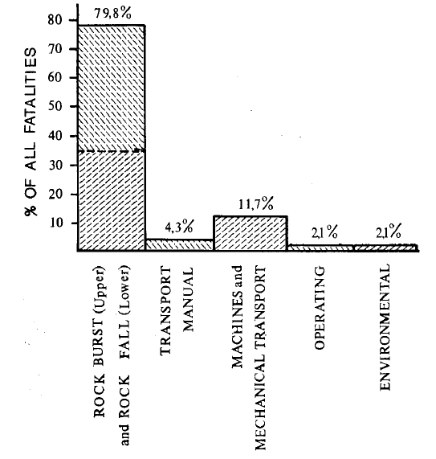
Why study rockbursts? ----fatal
岩爆研究的重要性
High fatality rates
Loss in production and equipment
Detrimental influence on labour recruitment
南非统计数据：79.8%的矿山事故与岩爆有关。
The combined fatality rate due to rock bursts and rock falls was 79.8 per cent of all fatalities for the mine.
Heunis R. 1980
Notes:
Besides high fatality rates, rockbursts also cause loss in production and equipment and place detrimental influence on labour.

Slide 5
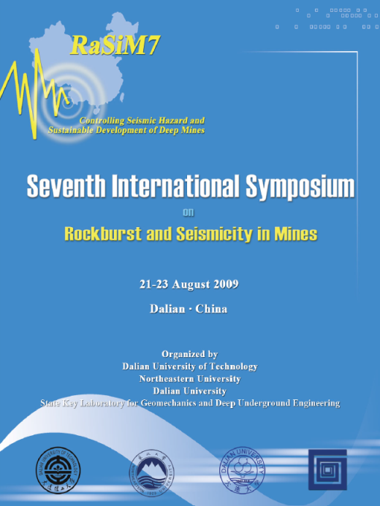
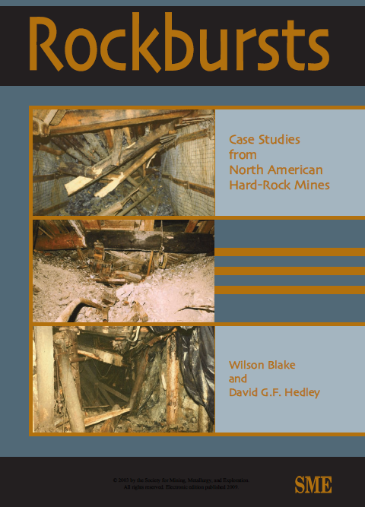

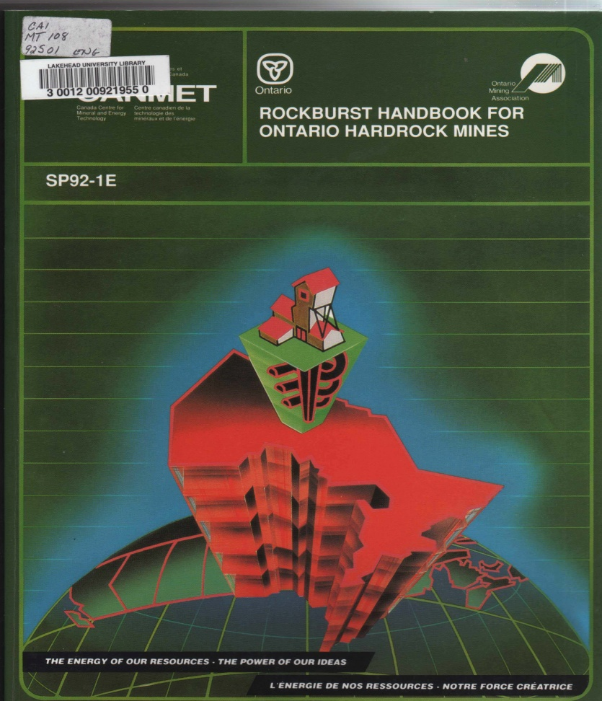
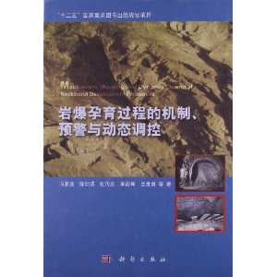
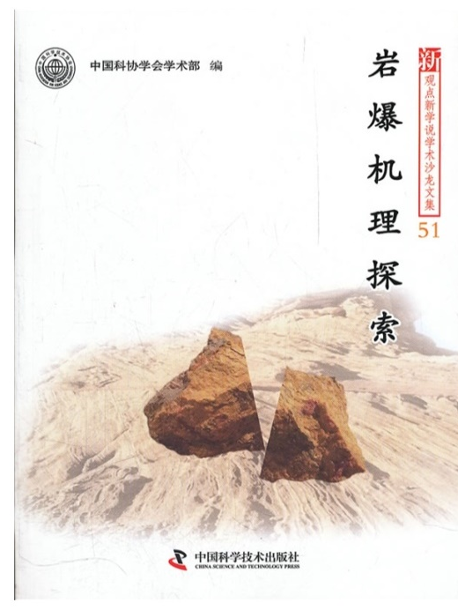

Slide 6
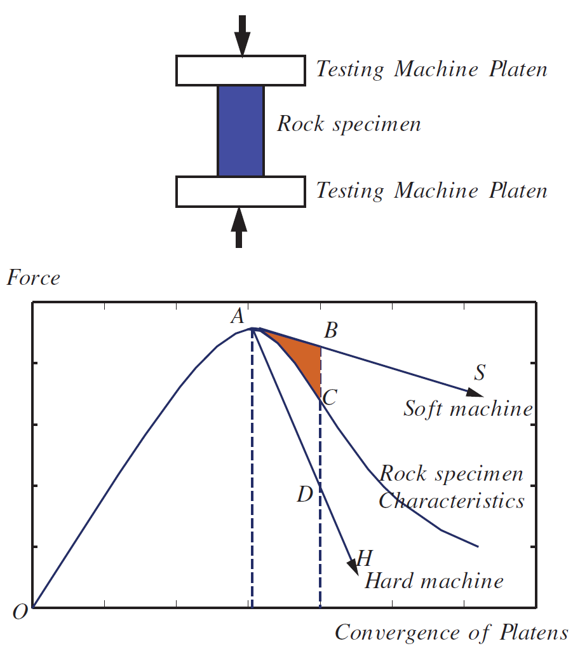
What’s the mechanism of rockbursts?
Literature review
岩爆研究的文献综述
An early explanation of rockburst phenomena is the mechanics of crushing of a rock specimen in a compression testing machine 岩石试验曲线特别是峰后曲线的能量解释 (Cook, 1966):

Slide 7
What’s the mechanism of rockbursts?
Literature review
岩爆研究的文献综述
Many other theoretical results on the mechanism of rockbursts and their prediction:
Catastrophic theory (灾变理论),
Micro-gravity method (微重力方法),
Energy release mechanism (能量释放),
Microseismic method (微震方法), etc.

Slide 8
Why to study rockbursts?----Unsolved
岩爆问题一直悬而未决
Rockbursts are the most serious and least understood (最严重的但了解最少的)problem facing deep mining operations all around the world (Wagner, 1982);
The pervasiveness of rockbursts suggests that they remain the major unresolved(主要的没有解决的问题) ground control problem in underground mining(Brady, 1990);
It is probably true that rockbursts have been the mining hazard that is the least understood and the most feared (了解最少的最可怕的) (Ortlepp,2005).
In the 16th annual Kenneth Finlay Memorial Lecture in Australia, rockburst is the cancer in geomechanics (癌症) of contemporary deep mining (Suorineni, 2013).
中国有色金属学会，中国黄金协会，中国金属学会，中国岩石力学与工程学会的会议，沙龙等等
Notes:
Why? Because the problem of rockbursts is unsolved. Rockburst is the cancer in geomechanics of contemporary deep mining

Slide 9
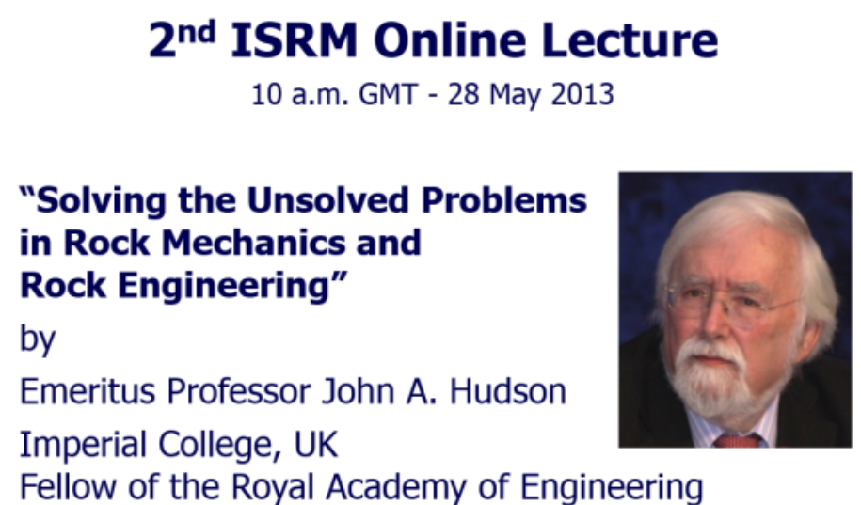
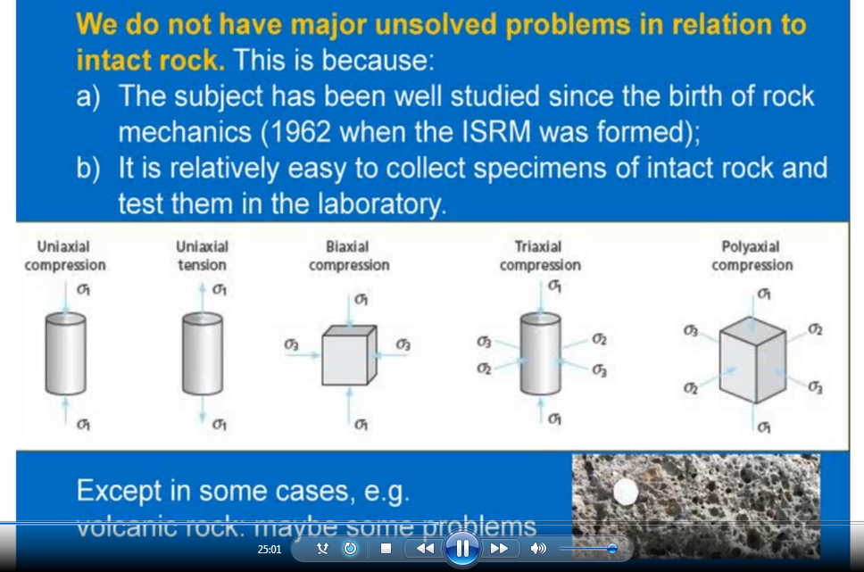
用岩石试件研究岩爆的局限性
Hudson院士认为：对于岩石试件的重要问题，
我们没有未解决的东西。
www.isrm.net

Slide 10
What are the limitations of using rock specimens to study rockbursts?
用岩石试件研究岩爆的局限性
The influence of geo-structures on rockbursts can not be fully considered (没有考虑采矿工程结构的影响，导致不区分矿柱岩爆，顶板岩爆，隧道岩爆，侧壁岩爆等)
The dynamically-induced effects of rockbursts are not properly accounted for (尚未建立动力参数的幅值、相位、频率，谱密度等与岩爆的严格的数量关系)
It has been acknowledged that dynamic failure between materials and structures are quite different (Shukla 2010).
(Shukla教授认为岩石材料与岩石工程结构的破坏机理是不同的)
Notes:
Using rock specimens to study rockbursts has the following limitations:

Slide 11
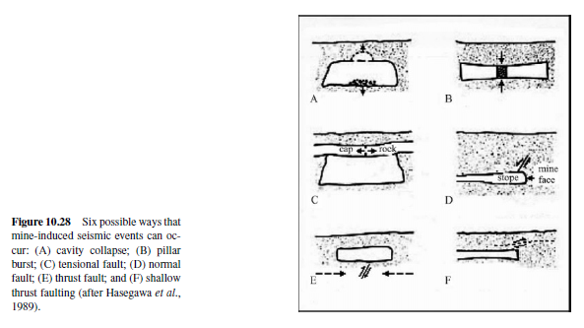
Why pillar rockbursts?
矿柱岩爆研究的重要性
Pillar burst is one of the six mine-induced seismic events (矿柱岩爆是6类矿震之一，Brady and Brown,2004)

Slide 12
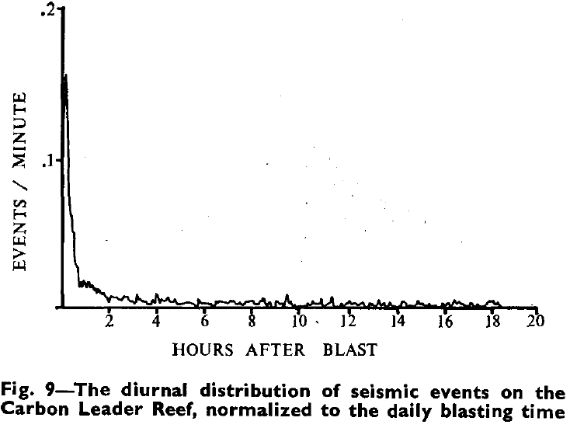
Why to study rockbursts stimulated by blasting?
研究爆破诱发岩爆问题的重要性
南非Heunis R. 1980
Many rockbursts occur at the time of a blast or shortly afterwards.(Hedley DGF, 1992加拿大统计数据表明，多数岩爆与爆破几乎同时发生)
Blasting was found to increase the probability of rockbursts by up to 500%, depending on the distance and amount of blasting. (Heunis R. 1980 据南非统计，爆破将增加岩爆发生率500%)

Slide 13
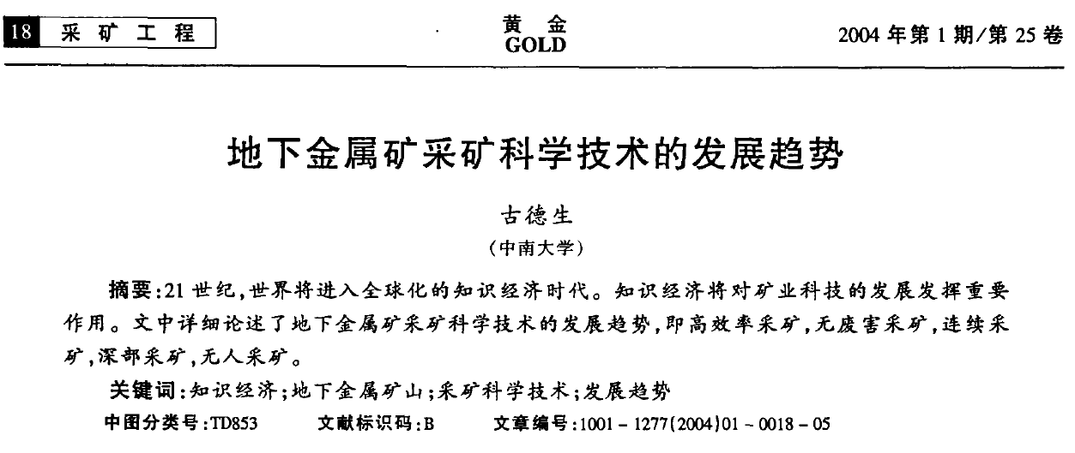
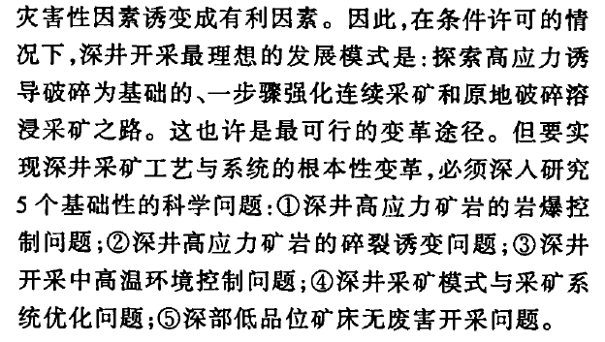

Slide 14
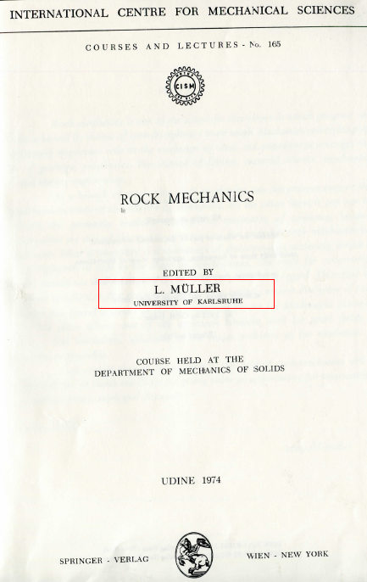
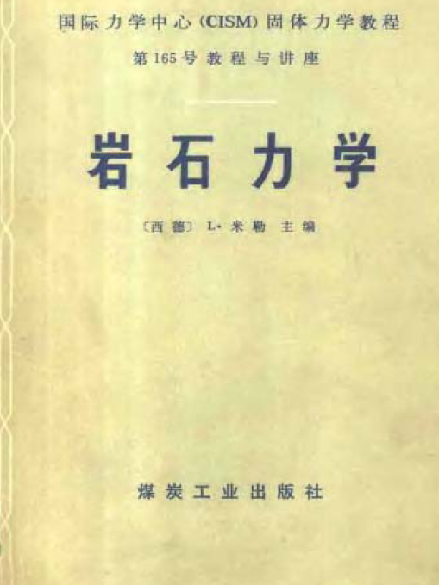
研究岩石工程问题到底应从小岩块试验的角度还是应从岩体工程结构的角度？
How to study rockbursts?
如何更合理地更有效地研究岩爆？……

Slide 15
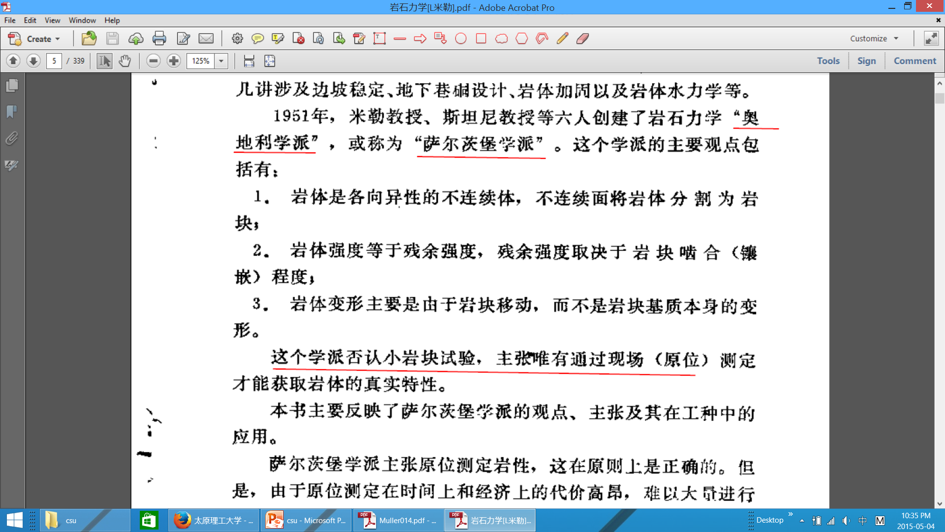
Mǚller教授认为岩石力学研究应从岩体工程结构的角度
而不是从小岩块试验

Slide 16
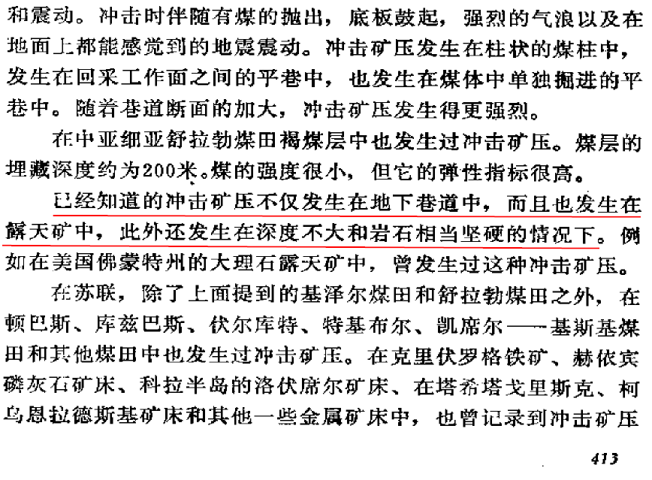
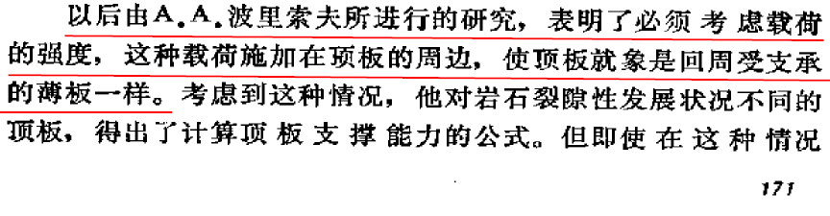
矿山岩石力学基础
(苏)屠尔昌宁诺夫(И.А.Турчанинов)
刘听成 等译, 煤炭工业出版社: 1981

Slide 17
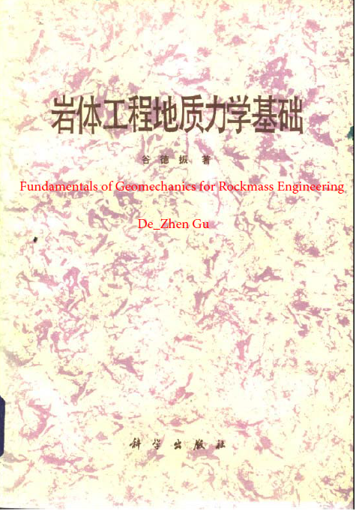
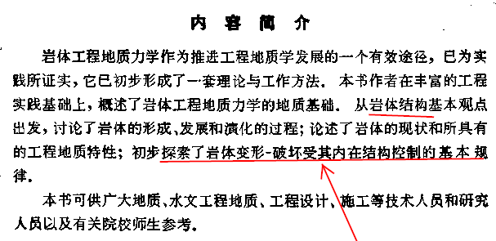
谷德振院士 认为应从岩体结构基本观点出发。

Slide 18

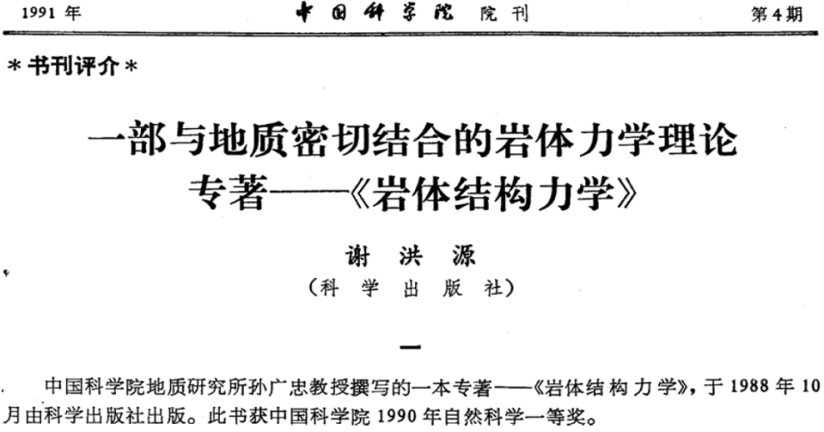
孙广忠教授发展到岩体结构力学

Slide 19

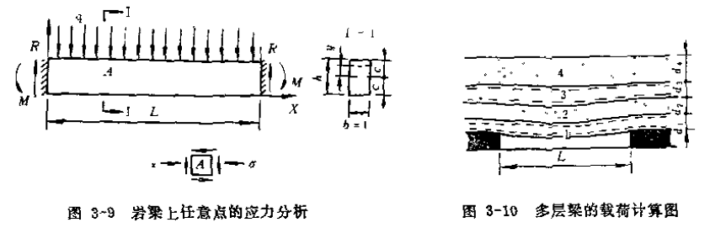

Slide 20
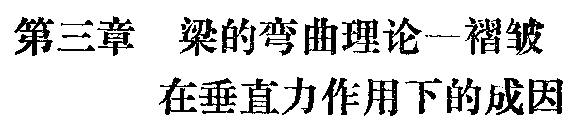
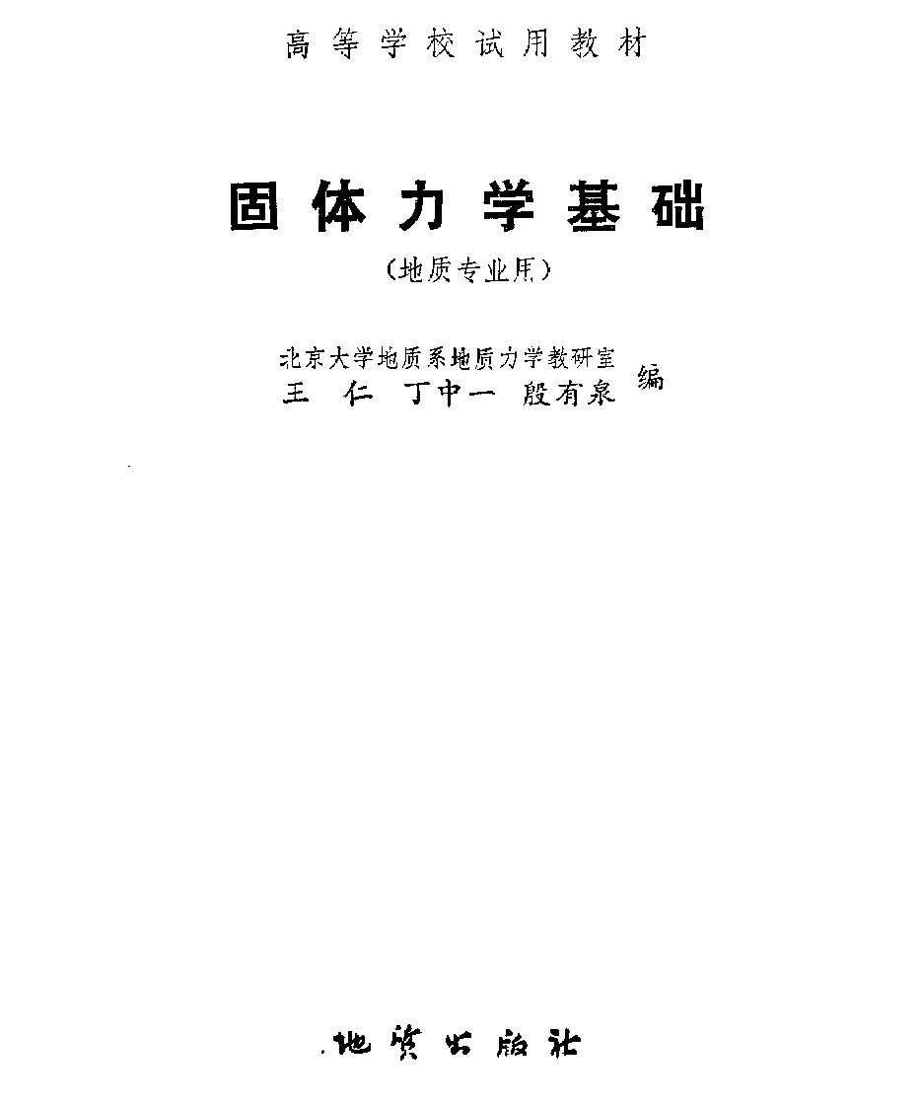
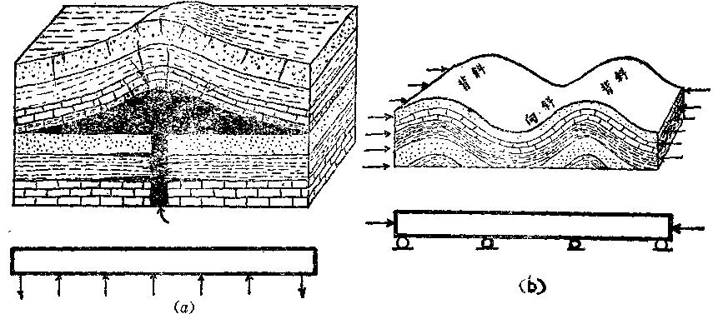
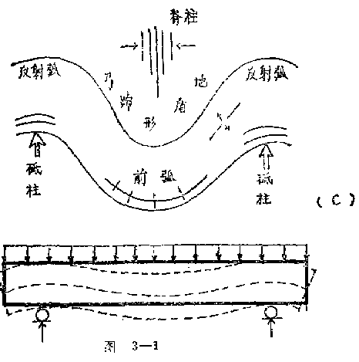

Slide 21
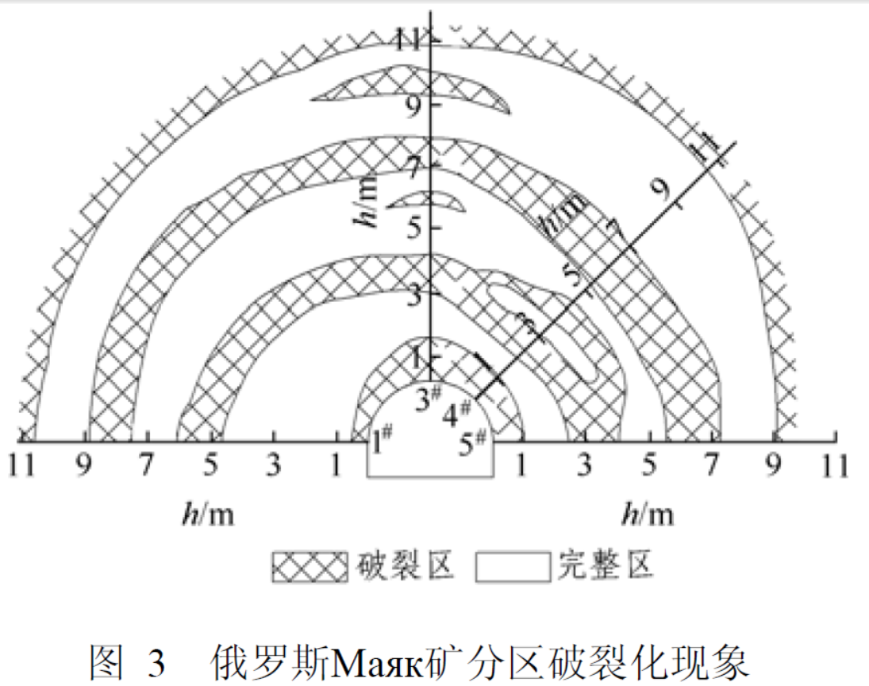
分区破裂化的研究为深部巷道结构拱提供坚实基础。
(钱七虎等,2009)

Slide 22
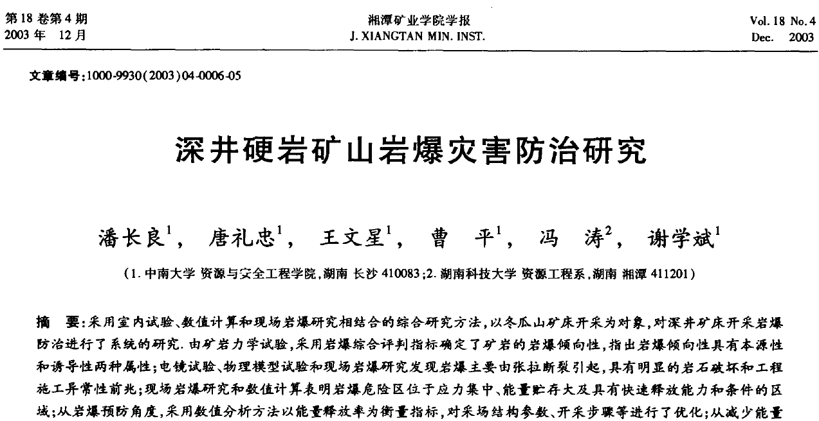

Slide 23
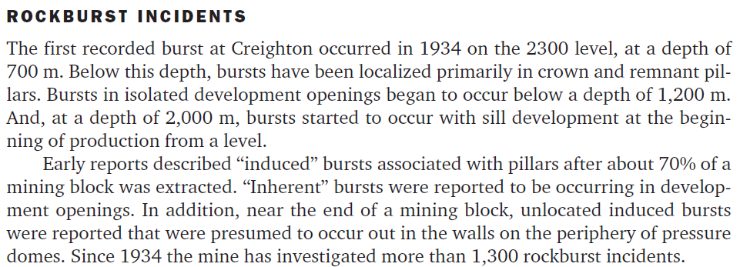

Slide 24
My proposal:
Rockbursts can be considered as a stability problem, or instability phenomenon(岩爆是动力不稳定现象);
Structural rock mechanics are concerned with the stability of engineering structures in which the material is predominantly rock.(结构岩石力学，Hoek 1986)
Many rockbursts are induced or triggered by dynamic loadings or stress fluctuations (多数岩爆是诱发的);
岩爆研究路径
Rockbursts should be studied as a problem of structural dynamic instability (结构岩体动力不稳定理论)from the point view of structural rock dynamics.
Notes:
Since many rockbursts……

Slide 25
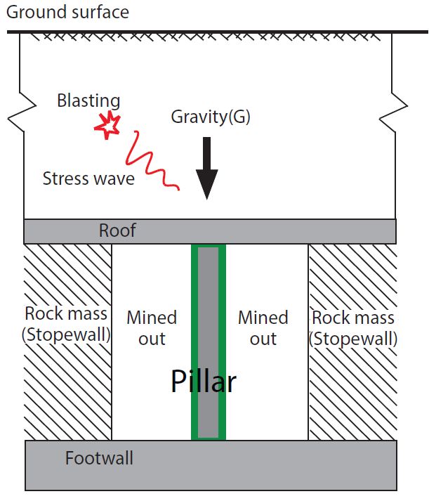
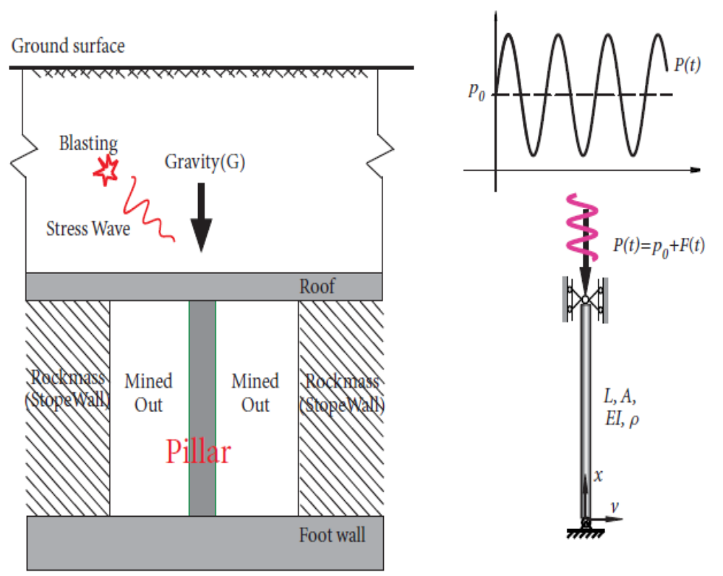
矿柱岩爆模型-----一个典型的爆破诱发岩爆
Notes:
In deep metal mines, pillars are usually subjected to both superincumbent and dynamic forces, as shown in the figure. The superincumbent forces, such as the gravity of the overburden are static.

Slide 26
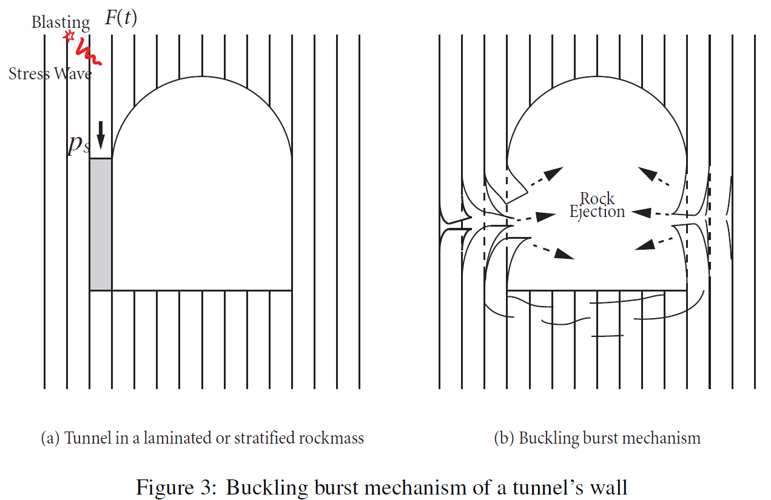
我们的模型也可用在层状岩层中的侧壁岩爆

Slide 27
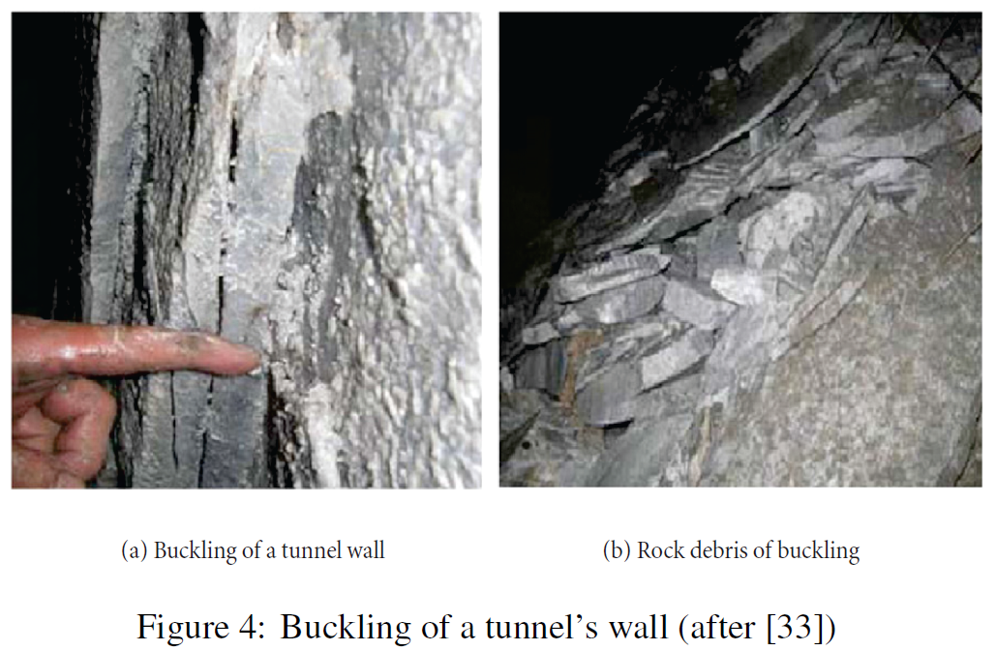
隧道侧壁岩爆实例图片
吴世勇等,2010

Slide 28
爆破诱发的矿柱岩爆必须解决4个问题：
爆破扰动传播到矿柱的规律
矿柱在扰动状态下的控制微分方程
基于控制微分方程的岩爆模型与边界条件
预测与减轻岩爆的措施

Slide 29
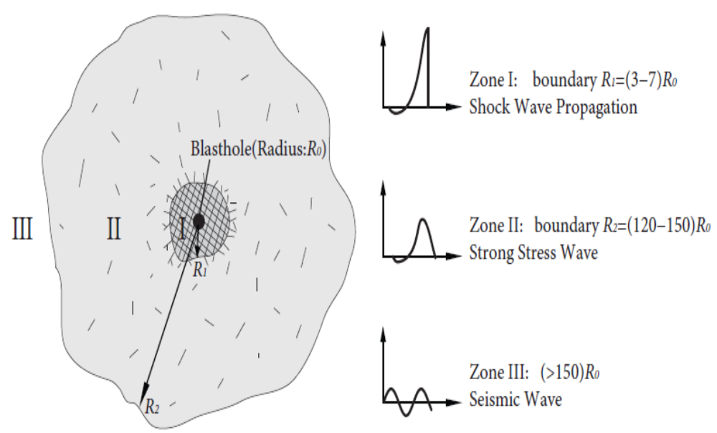
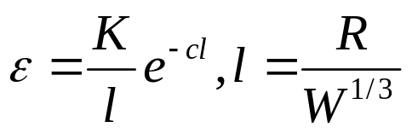
Dynamic loadings on pillars
爆破参数与动力扰动的关系

Slide 30
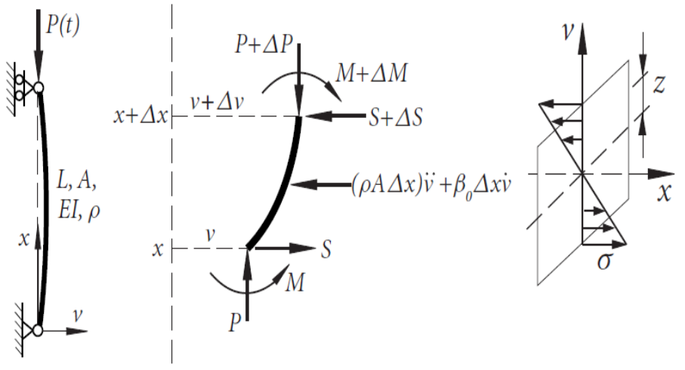
爆破诱发矿柱岩爆的数学物理模型
Pillar’s dynamic equation of motion
where q(t) is the transverse displacement.
$β=\frac{β_{0}}{2ρA}, ω_{n}^{2}=\frac{EI}{ρA}{\left(\frac{nπ}{L}\right)}^{4}, P_{n}=EI{\left(\frac{nπ}{L}\right)}^{2}$, $ω^{2}=ω_{n}^{2}\left(1−\frac{p_{0}}{P_{n}}\right), 2μ=\frac{p_{1}}{P_{n}−p_{0}}$

Slide 31


根据矿柱岩爆的动力扰动与矿柱上静压力的关系，岩爆的数学模型
Inherent Rockbursts (内生岩爆)
The causative force is only the stress on the pillar.
$$\ddot{q}\left(t\right)+ω^{2}q(t)=0$$
The method of Eigenvalue: dynamic instability regions
Triggered Rockbursts (诱导岩爆)
The causative force is relatively small as compared the stress on the pillar.
$$\ddot{q}\left(t\right)+ω^{2}(1−2ϵμ\cos{νt)}q(t)=0, 0<ϵ≪1$$
The method of averaging: dynamic instability regions
Induced Rockbursts (激励岩爆)
The causative force is comparable to the stress on the pillar
$$\ddot{q}\left(t\right)+ω^{2}(1−2μ\cos{νt)}q(t)=0$$
The method of eigenvalue analysis: dynamic instability regions

Slide 32
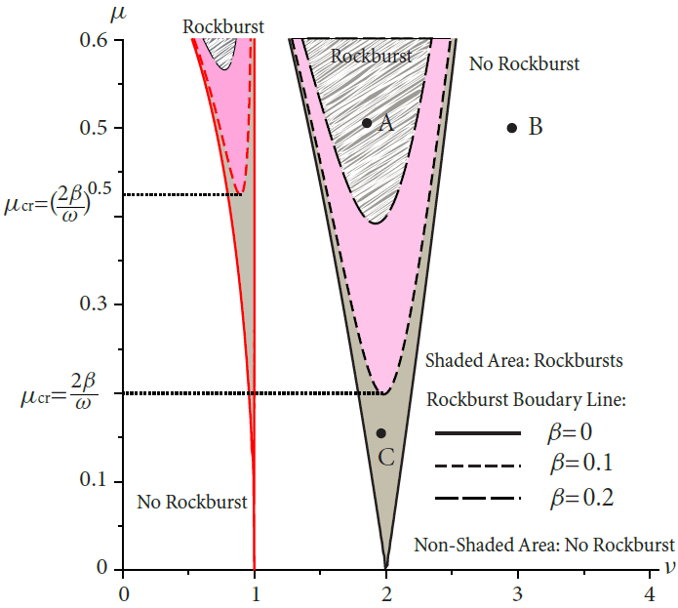
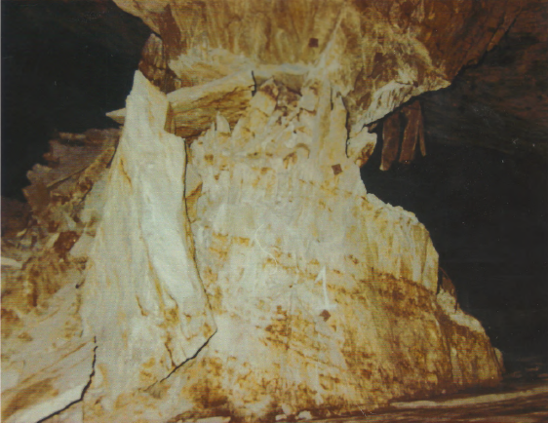
Dynamic instability and Triggered Rockbursts
(诱导岩爆的区域)
幅值
频率
If the point lies in the blank region, e.g., B, then the pillar is stable with bounded responses, which means that no rockbursts occur. (边界外无岩爆)
The system is unstable, and the response grows exponentially with unbounded motion. (边界内发生岩爆，位移成指数增长：猛烈、突然)
This gives another explanation of the failure mode of fretting or necking of pillars from the displacement point of view. (可以解释深部矿柱的破坏形态)

Slide 33
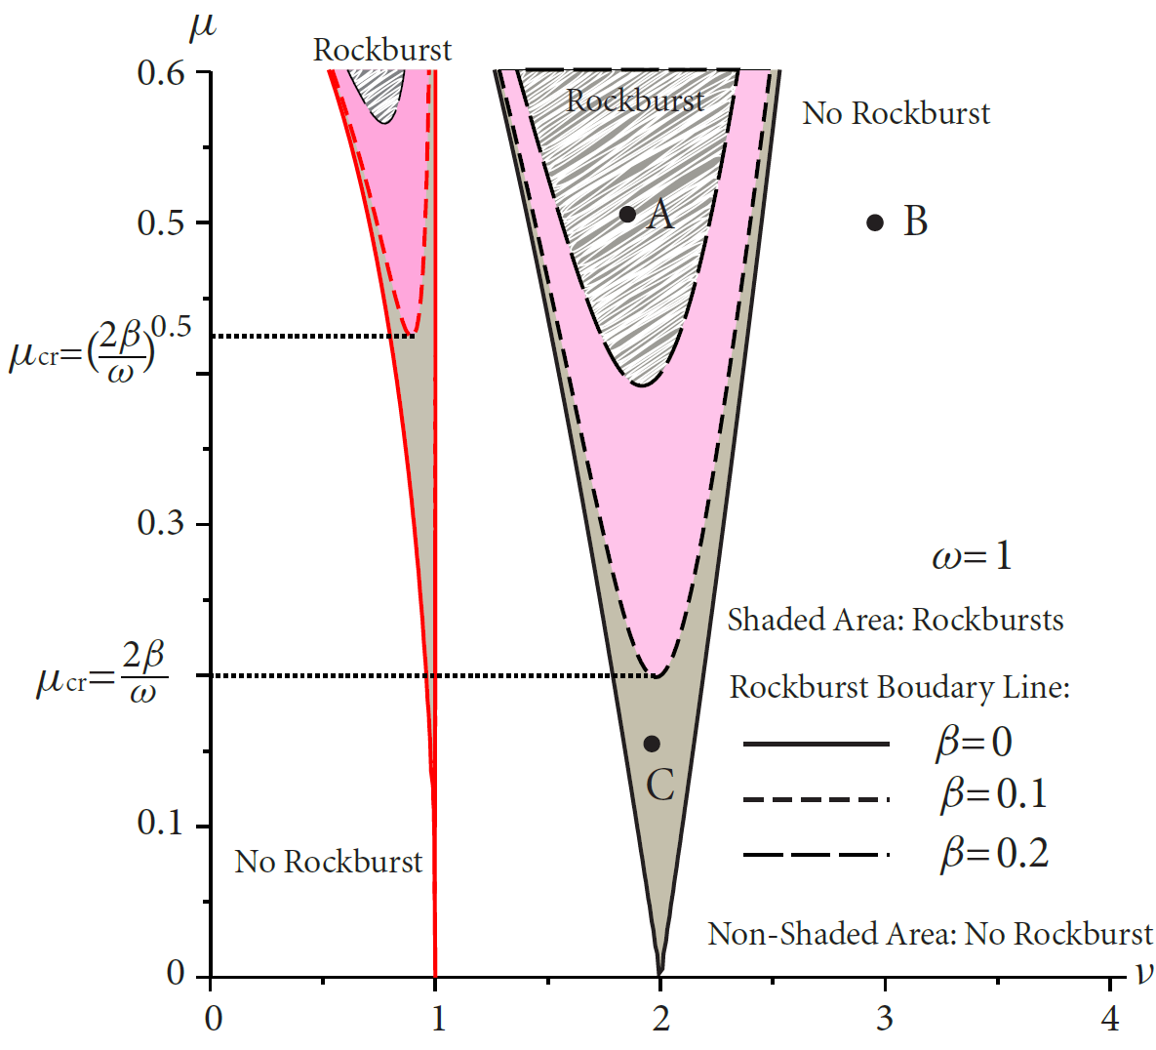
Damping effect（阻尼效应）: With the increase of rock damping, the minimum excitation amplitude increases accordingly, which suggests damping could reduce the rockburst occurrence.
Perturbation effect（摄动效应）: rockbursts may occur even if the excitation amplitude is small during parametric resonance.
Mechanism of parametric resonance（参数共振效应）: the excitation frequency is twice the pillar natural frequency.

Slide 34
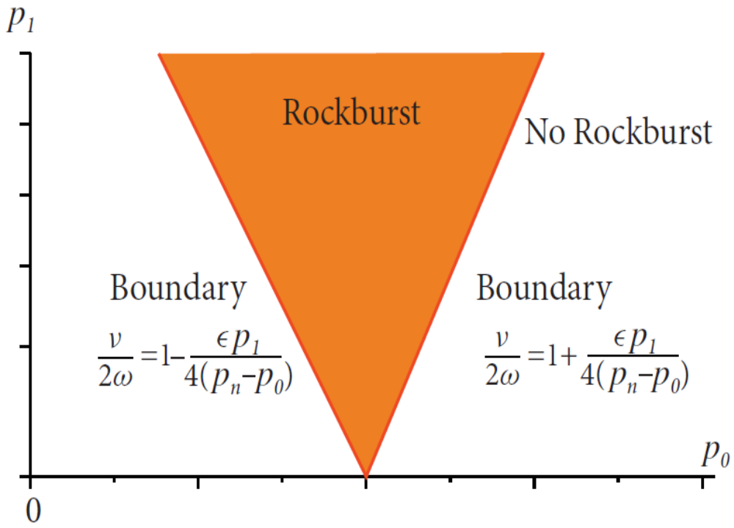

扰动幅值
静应力
Static and dynamic forces for rockbursts
Rockbursts may occur at all depth of excavations.
（岩爆可能发生在任何深度，深度增加只是增加了发生的可能性，这与前苏联学者 屠尔昌宁诺夫 的观测相一致）
In rockbursts, the stress in the rock does not necessarily exceed its strength.（岩爆矿柱的原岩应力不一定超过岩石的强度）

Slide 35
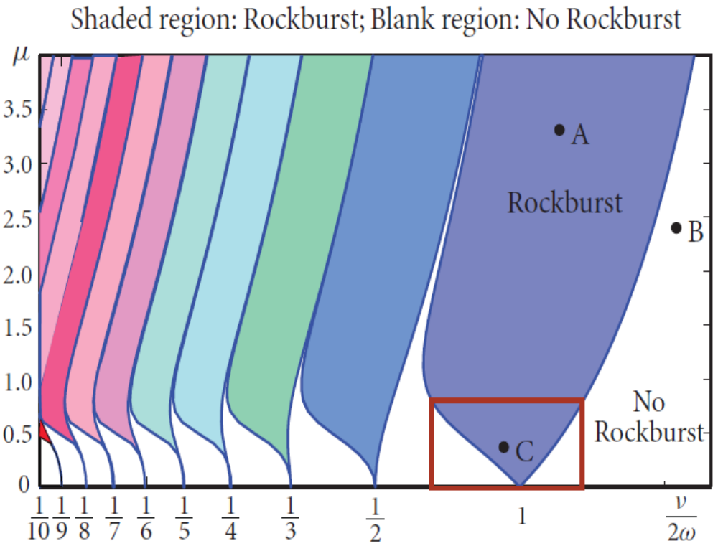
INDUCED ROCKBURSTS(激励岩爆）
The boundaries are nonlinear and complex Nonlinear Effect
(复杂的非线性效应)
The occurrence：amplitude and frequency relationship
(并不是爆破扰动越大,岩爆就一定发生)
Mechanism of De-stressing Blasting: to reduce μ
(卸压爆破减轻岩爆的机理)

Slide 36
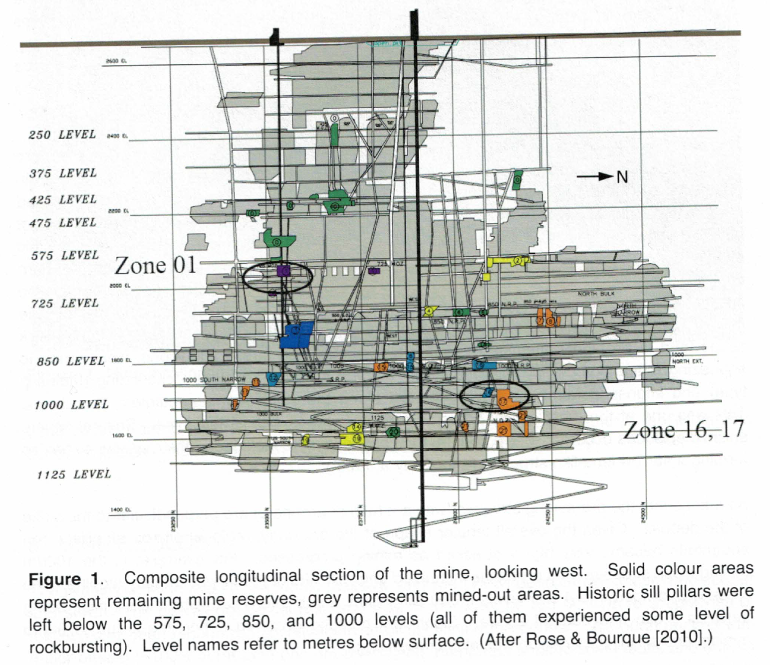
A case study 实例研究

Slide 37
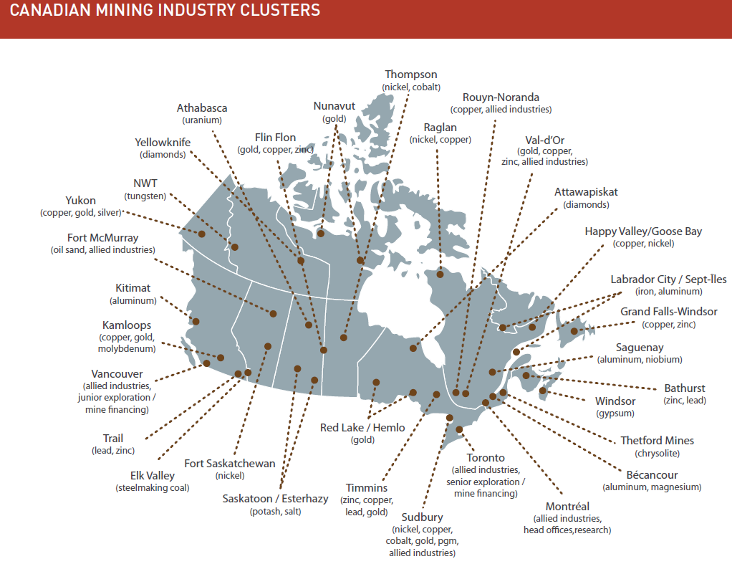
加拿大主要金属矿产分布

Slide 38
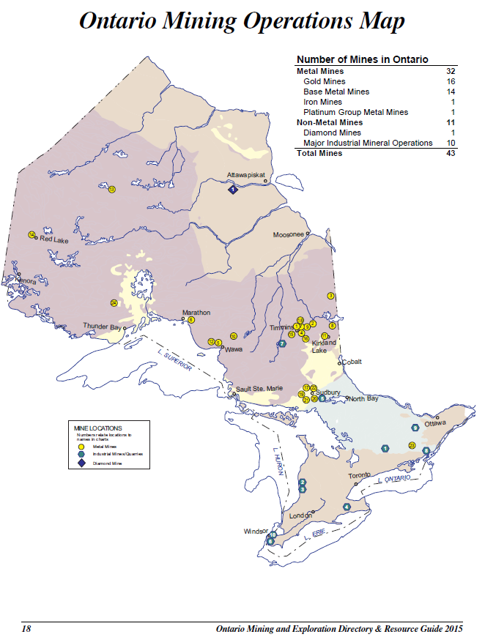
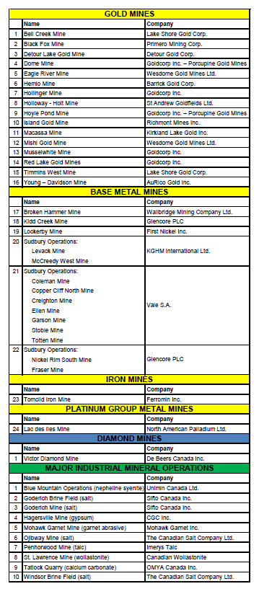

Slide 39
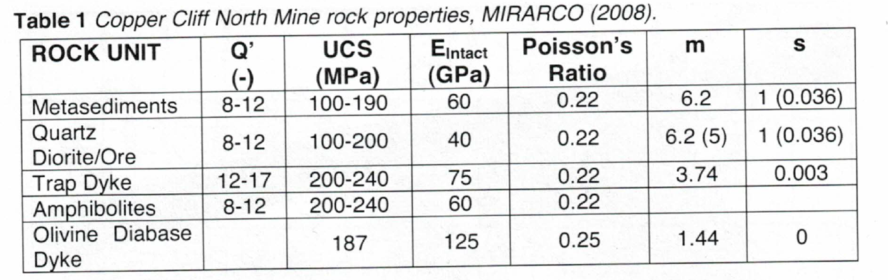
Geology 地质情况

Slide 40
Mining Methods 采矿方法
Vertical Retreat Blasthole (VRM)
Slot-and-Slash
Upper Retreat Mining (URM)
Avoca or Rill Mining

Slide 41
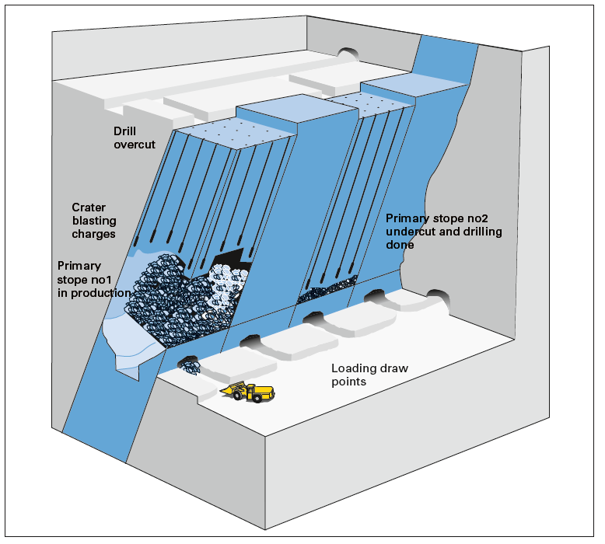
Hill, et al. 2012

Slide 42
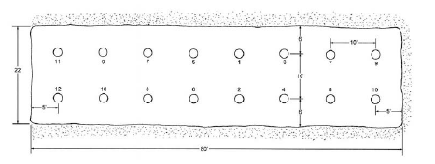
Drilling 凿岩
Drilling is done with an ITH(DTH) drill set up in the overcut. Holes are 165 mm (6 1/2 in.) diam, are vertical, and average 56 m (185 ft) in length. All holes are drilled to break through into the undercut.
Blasthole pattern:

Slide 43
Blasting 爆破
Packaged slurry (water gel) is used as the explosive, 条状浆状炸药
and approximately 34 kg (75 lb) are required for this length.
All holes in one horizontal lift of the pillar are loaded and fired on one blast. Holes are delayed using either LP or SP millisecond delay blasting caps.

Slide 44
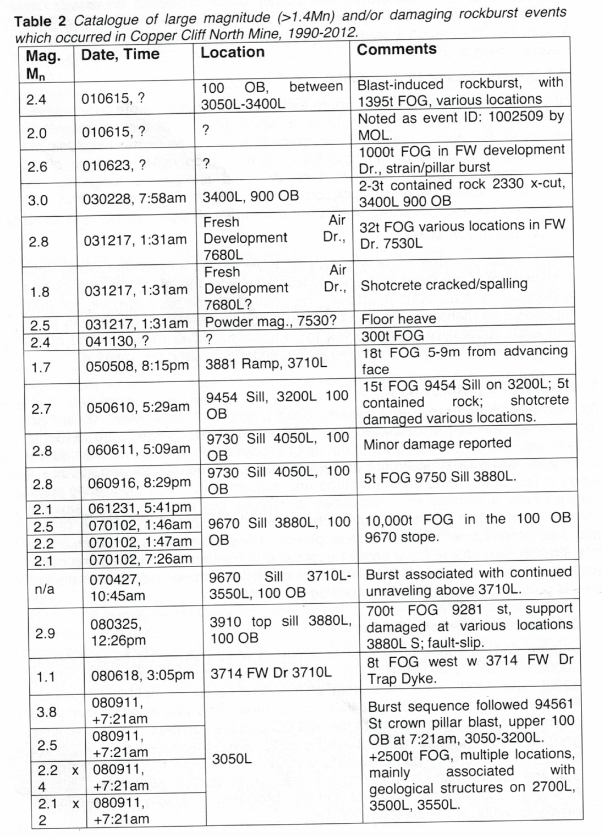
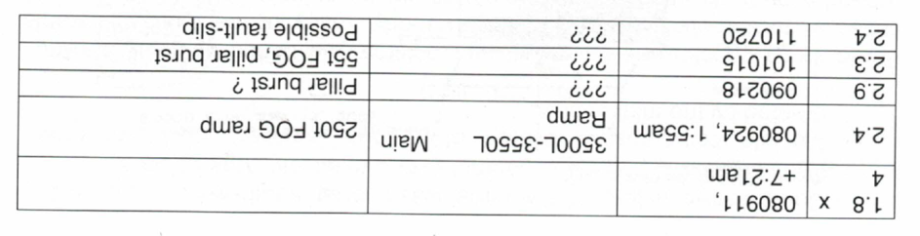
矿山的岩爆记录

Slide 45
35 kg Packaged slurry 10m rockburst.

Slide 46



Slide 47
Rockburst Mitigation Measures
减轻岩爆措施
De-stress Blasting 卸压爆破
Dynamic Enhanced Support 加强支护
Blasting Parameters and Mining Sequencing 爆破参数和开采顺序
Micro-seismic Monitering 微震监测系统

Slide 48

Dynamic enhanced support

Slide 49
Conclusions 结 论
Inherent Rockbursts, Triggered rockbursts and induced rockbursts (内生岩爆，诱导岩爆，激励岩爆)
Rigorous mathematic models (严格的数学模型)
Quantitative relationship: between blasting parameters and pillar rockbursts (爆破参数与岩爆的数量关系)
Mechanism of parametric resonance of pillar rockbursts (岩爆参数共振机理)
A case study (实例研究)

Slide 50



致谢(Acknowledgements)

Slide 51

问题？
E-mail: jian.deng@lakeheadu.ca
Notes:
http://www.nce-rce.gc.ca/NetworksCentres-CentresReseaux/BLNCE-RCEE/UDMN-RRDEMP_eng.asp
http://www.nrcan.gc.ca/home
https://www.miningdeep.ca/?page_id=31
http://mining.ca/resources/mining-facts
http://mining.ca/

